Slide 1
Q1 2013 CAR Analysis
Team:
Bill Konigsfeld
Alan Purvey
Jenni Murrill

Slide 2
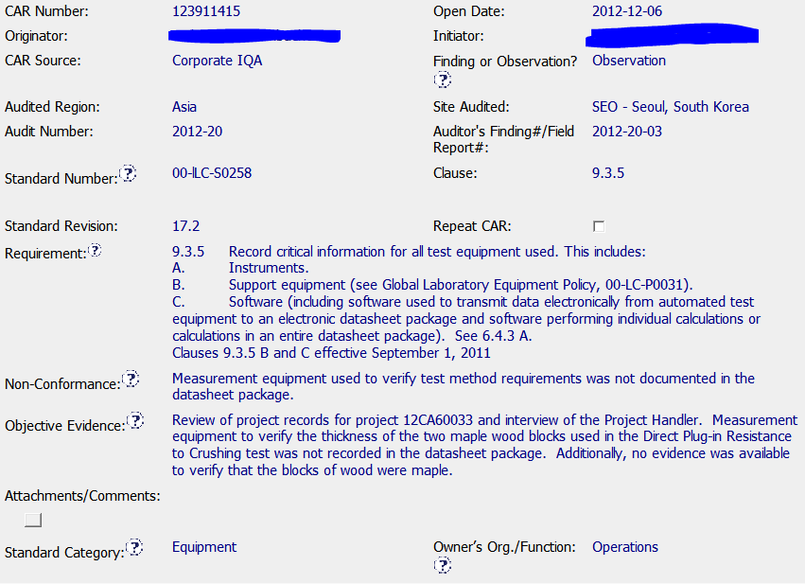
Observation 123911415
NCR: Suitable information, including identification of the project reviewed, is properly stated in the Requirement, NCR and Obj. Evidence sections.
Background
For future Observations, 1 of XX records reviewed will be documented.

Slide 3
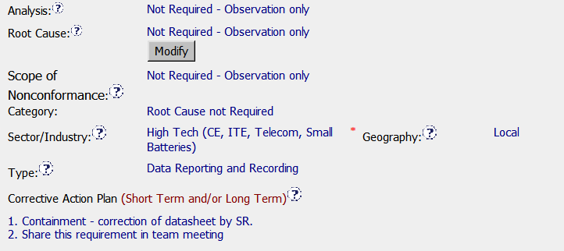

Observation 123911415
Response
Correct Root Cause Category for Observation
Milestones
Correction: datasheet updated to include wood blocks and calipers used for verification. Calibration record verifies the wood is Maple.
- Cited NCR corrected.
- Good practice of sharing with team, though this could have been handled outside of the CAR.

Slide 4


Observation 123911415
Verification
Simple, immediate verification for Observation

